Slide 1

Laughacademy
☺ THE MISSION ☺

Slide 2
Clown School
Mission statement :
bring laughter and joy into the world as well as promote extraordinary theatrical classes and events for adults and children alike.
Value statement :
We anchor our work in the discipline of clown because we believe that clowning embraces and celebrates the totality of human experience and oﬀer unparalleled freedom in art.
Core values :
« Freedom of expression » & « the love of play ».
Core assets :
Our employees; « Teaching staff » & « main staff » (i.e.: leadership and support staff)

Slide 3
Web site prerequisites
A Fun and Colourful web sites that showcase our excellent team
and our fun attitude.
Emphasizing our upcoming classes :
We want to showcase our upcoming classes that clients can sign up for.
Showing oﬀ our amazing staﬀ
Everyone smiling
Make our phone number obvious and easily be called.

Slide 4
Laughacademy
☺ THE Work ☺

Slide 5


BRAINSTORMING SESSION
Our research on competitors gave us the edge:
https://thelaughingacademy.com/
https://www.laughacademy.biz/
http://mitchlana.com/
We sought inspiration for fun colourful « Look and Feel » with that imagery and tone in mind.
Fortunately, our delays were so tight that we aimed for a layout with rounder fonts, larger sections for more breathing room, and more simple animation that didn't distract our users :
https://laugh-masters.com.au/
https://www.optimonk.com/
And we didn't want our client to have a Website that is only « a presence online. »

Slide 6
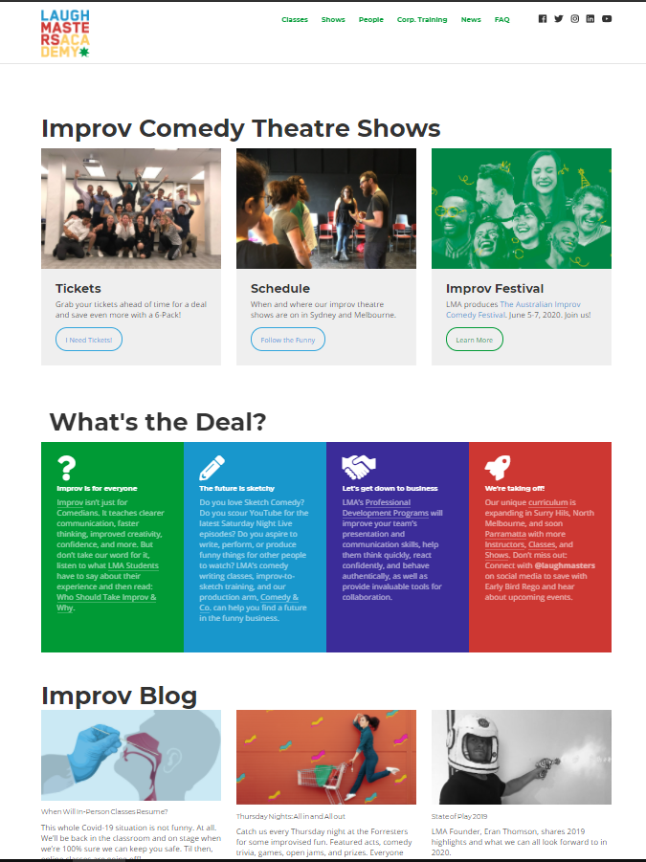

BRAINSTORMING – WE AGREED
So we all agreed on criteria like :
The page must have fun and colourfull
it should have images that incite the visitor to stay.
It may have a sign-up page
It may have the social media
There may be a page for the upcoming classes
The fonts should be clear and fun
And we all went our separate ways to submit different Wireframe...

Slide 7
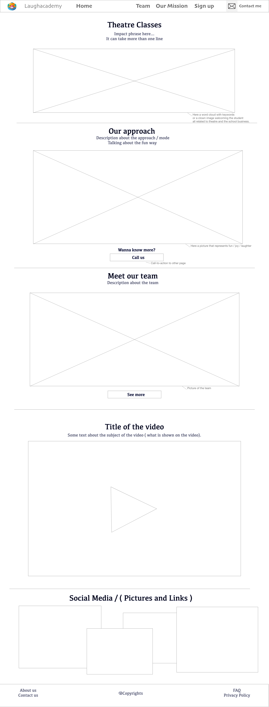
- Web Wireframe -

Slide 8
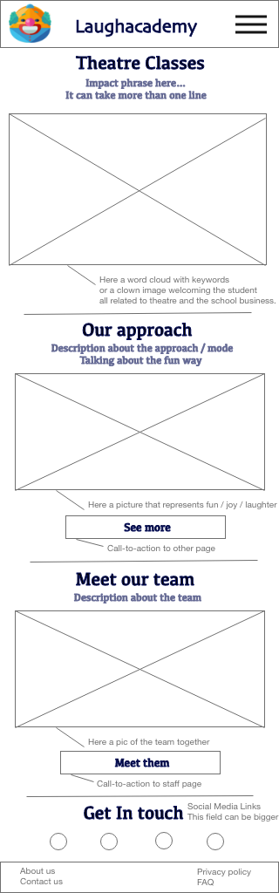
- Mobile Wireframe -

Slide 9
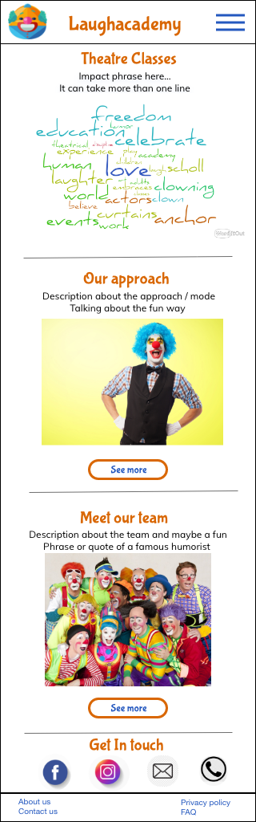
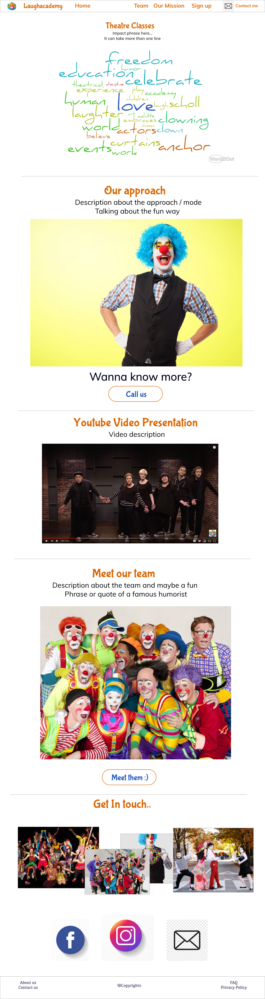
Mockup

Slide 10
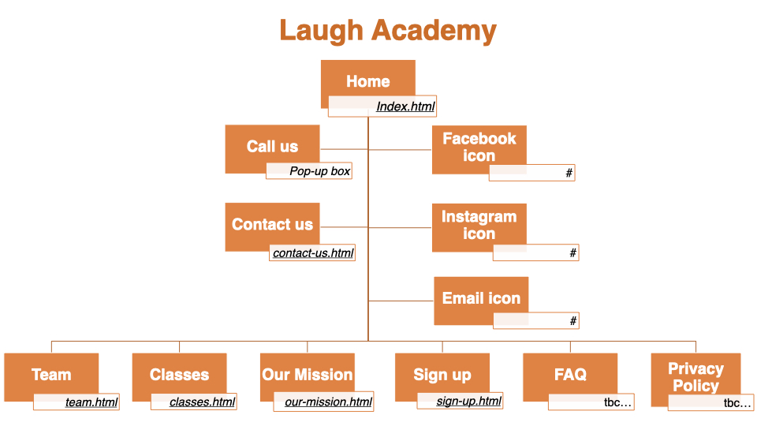
Sitemap and FLOW

Slide 11
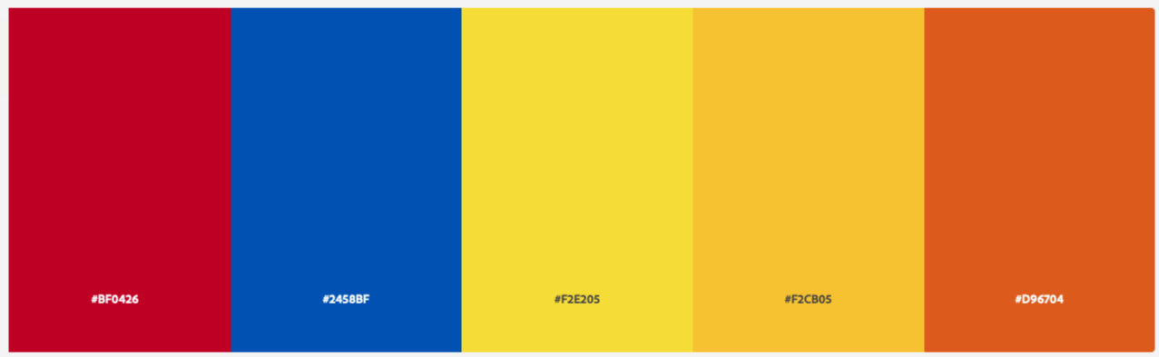
visual presentation & colour scheme
Red : #BF0426
Blue : #2458BF
Yellow 1 : #F2E205
Yellow 2 : #F2CB05
Orange : #D96704

Slide 12




font selection
- We used Google Fonts and those are the fonts we chose:
Bubblegum Sans
Mulish
Josefin Sans

Slide 13
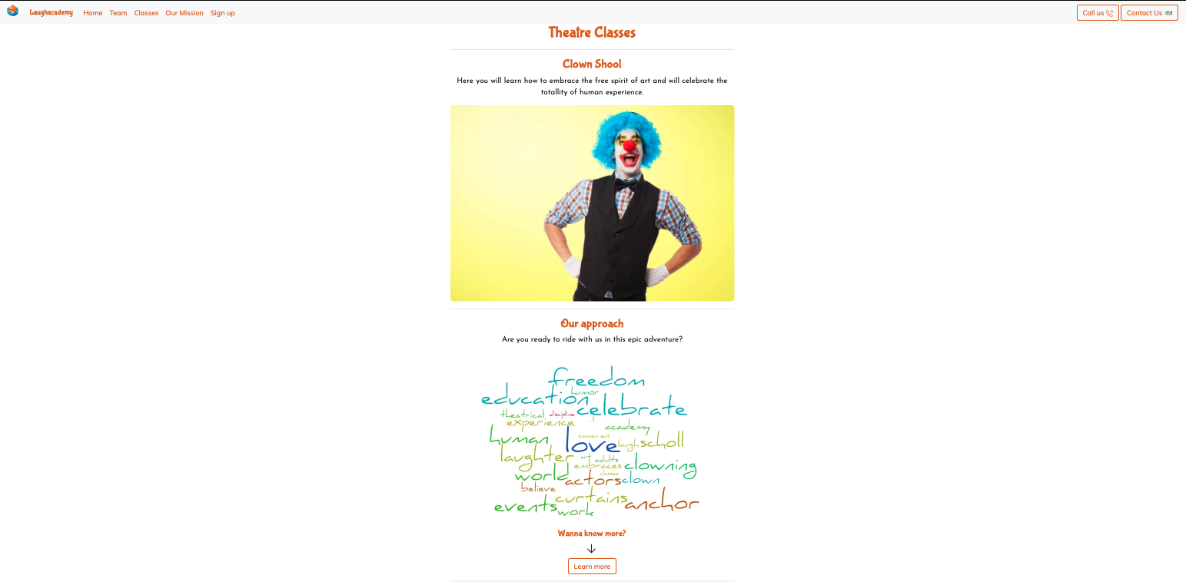
demonstration
Click here to visit
Our Website

Slide 14
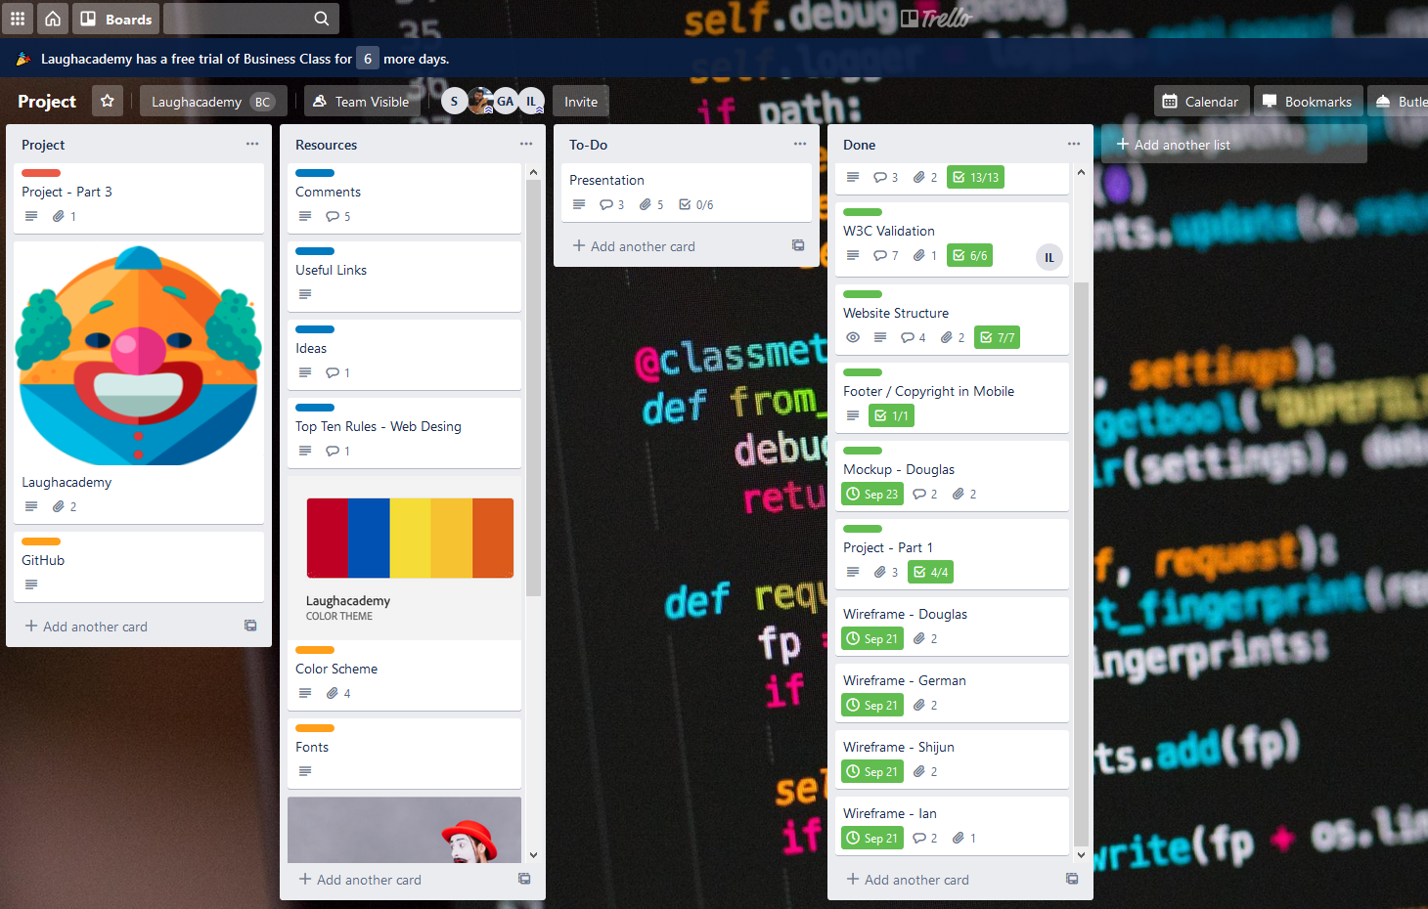
team work dynamics
We had regular meetings where we discuss different ideas. We used Trello’s boards to organize and prioritize tasks.
Slack and Teams for communication and ideas and Github to compile all the project.
- Team
Douglas Vinicio
Ian Laporte
German Acevedo
Shijun Wang

Slide 15
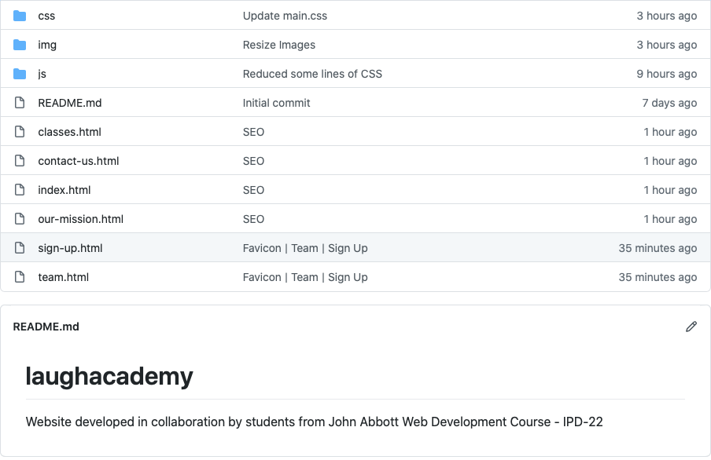
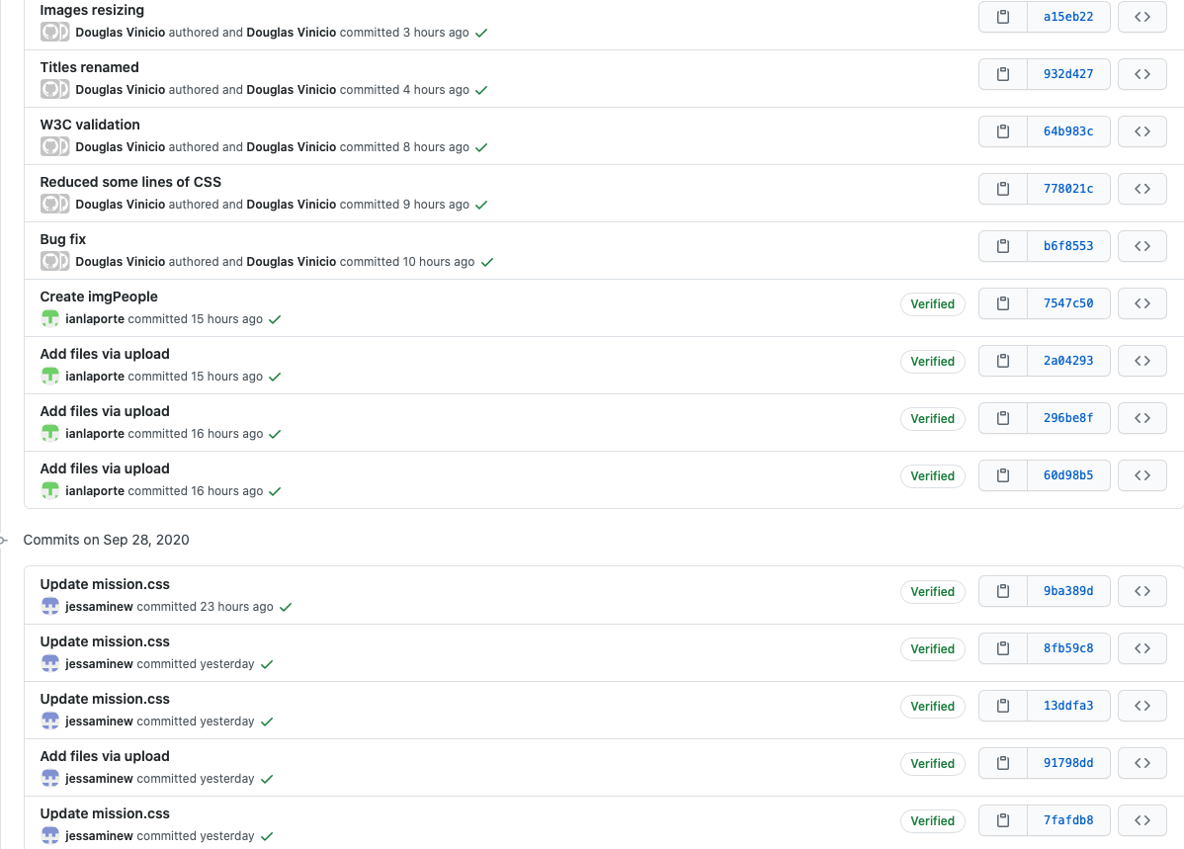
GitHub

Slide 16
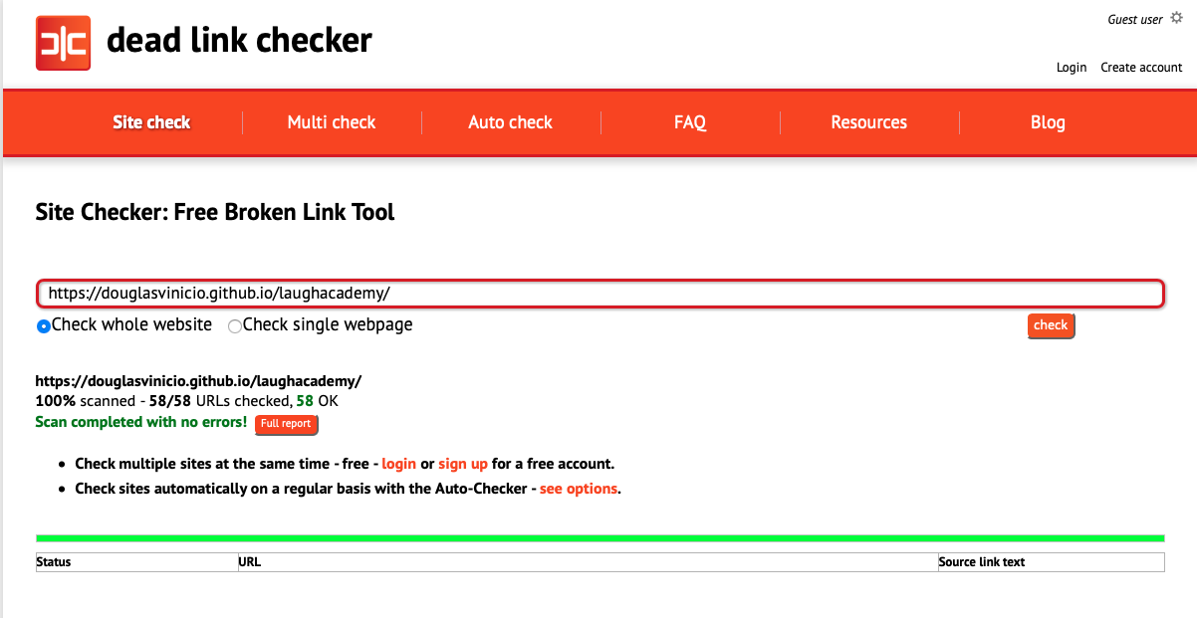
Dead Link checker

Slide 17
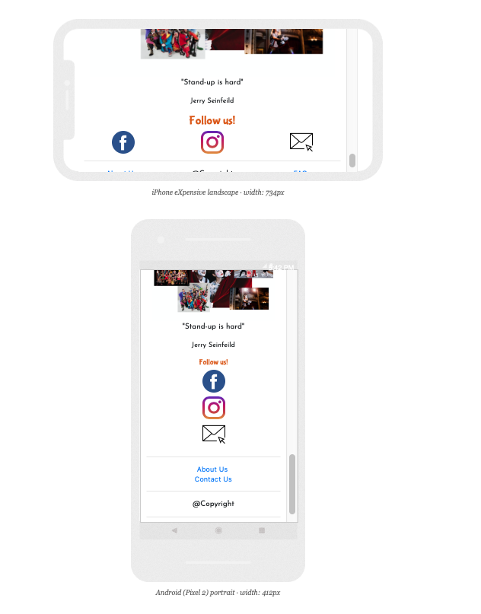
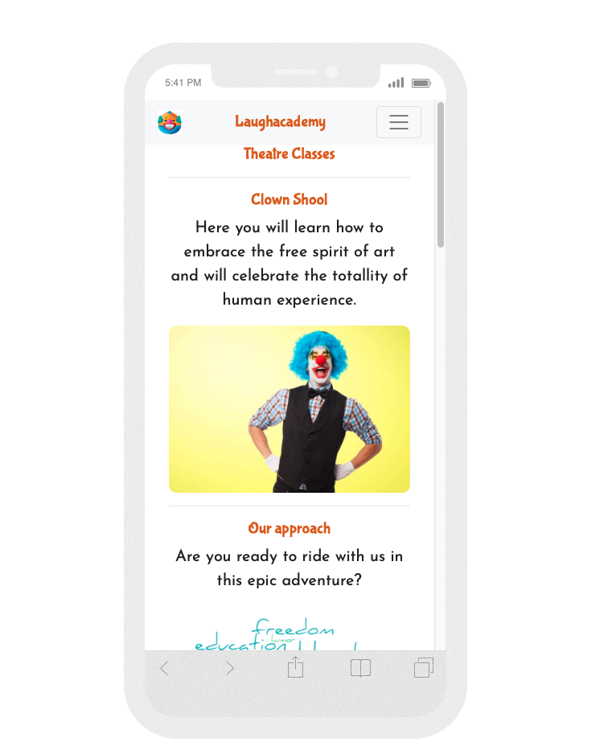
http://responsinator.com/

Slide 18
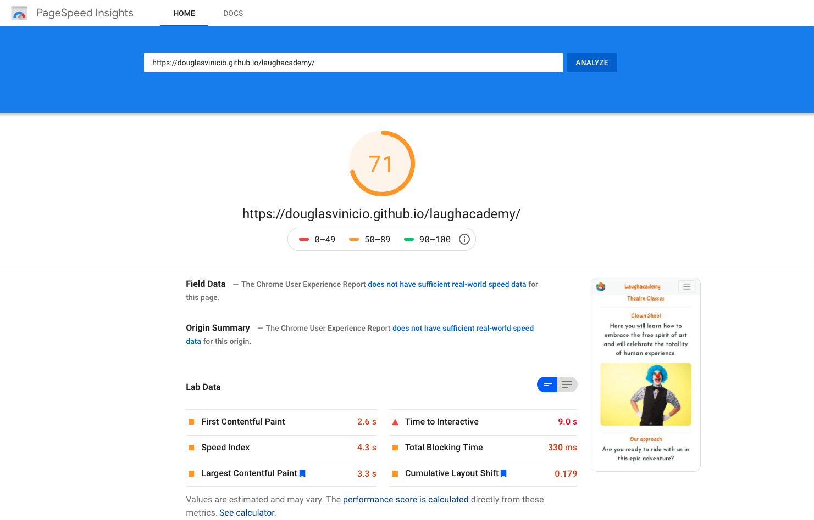
Score – Google page speed

Slide 19
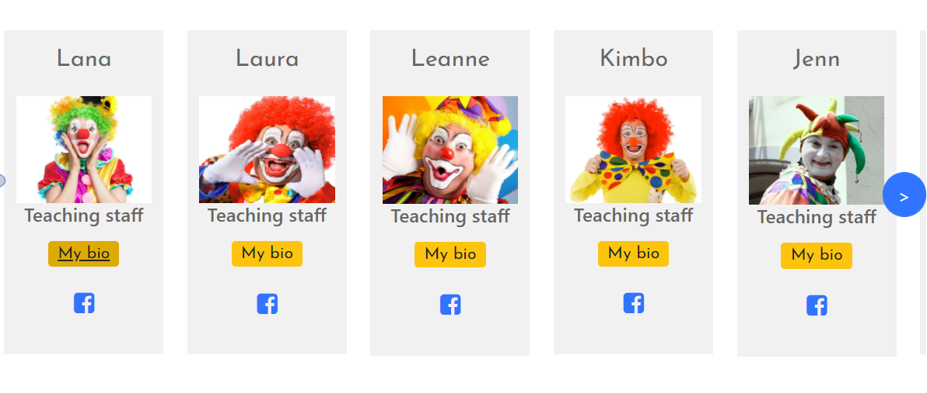
difficulties and solutions

Slide 20
Search engine optimization seo - (google search)
<meta name="description" content="Teaching how to make people laugh while having fun is our kind of art.
Our mission is to bring laughter and joy into the world as well as promote extraordinary
theatrical classes and events for adults and children. ">
<meta name="author" content="Laughacademy. http://index.html">
<meta name="robots" content="index,follow">

Slide 21
Search engine optimization sMo - (facebook)
<meta property="og:type" content="website">
<meta property="og:title" content="Laughacademy | Come laugh and learn with us!">
<meta property="og:url" content="http://index.html">
<meta property="og:image" content="/img/home/clown-hands-hips.jpg">
<meta property="og:description"
content="Teaching how to make people laugh while having fun is our kind of art.
Our mission is to bring laughter and joy into the world as well as promote
extraordinary
theatrical classes and events to adults and children. http://index.html/">

Slide 22
Search engine optimization sMo - (twitter)
<meta name="twitter:card" content="summary">
<meta name="twitter:site" content="@Laughacademy">
<meta name="twitter:title" content="Laughacademy | Come laugh and learn with us!">
<meta name="twitter:description"
content="Teaching how to make people laugh while having fun is our kind of art.
Our mission is to bring laughter and joy into the world as well as promote extraordinary
theatrical classes and events to adults and children. http://index.html">
<meta name="twitter:image" content="/img/home/clown-hands-hips.jpg">

